Slide 1
Object Detection Customisation Website -- User Manual
By Yichen

Slide 2

Home page

Slide 3
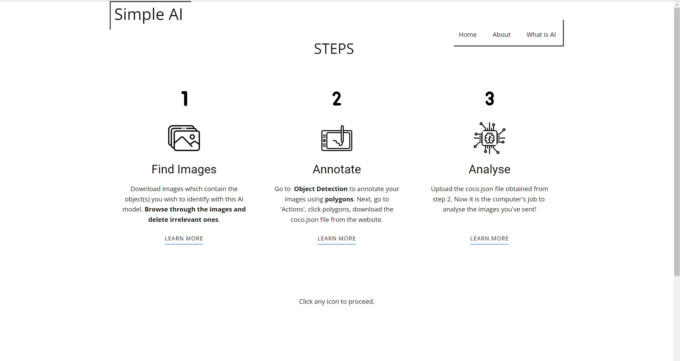
STEPS

Slide 4
STEP 1

Slide 5
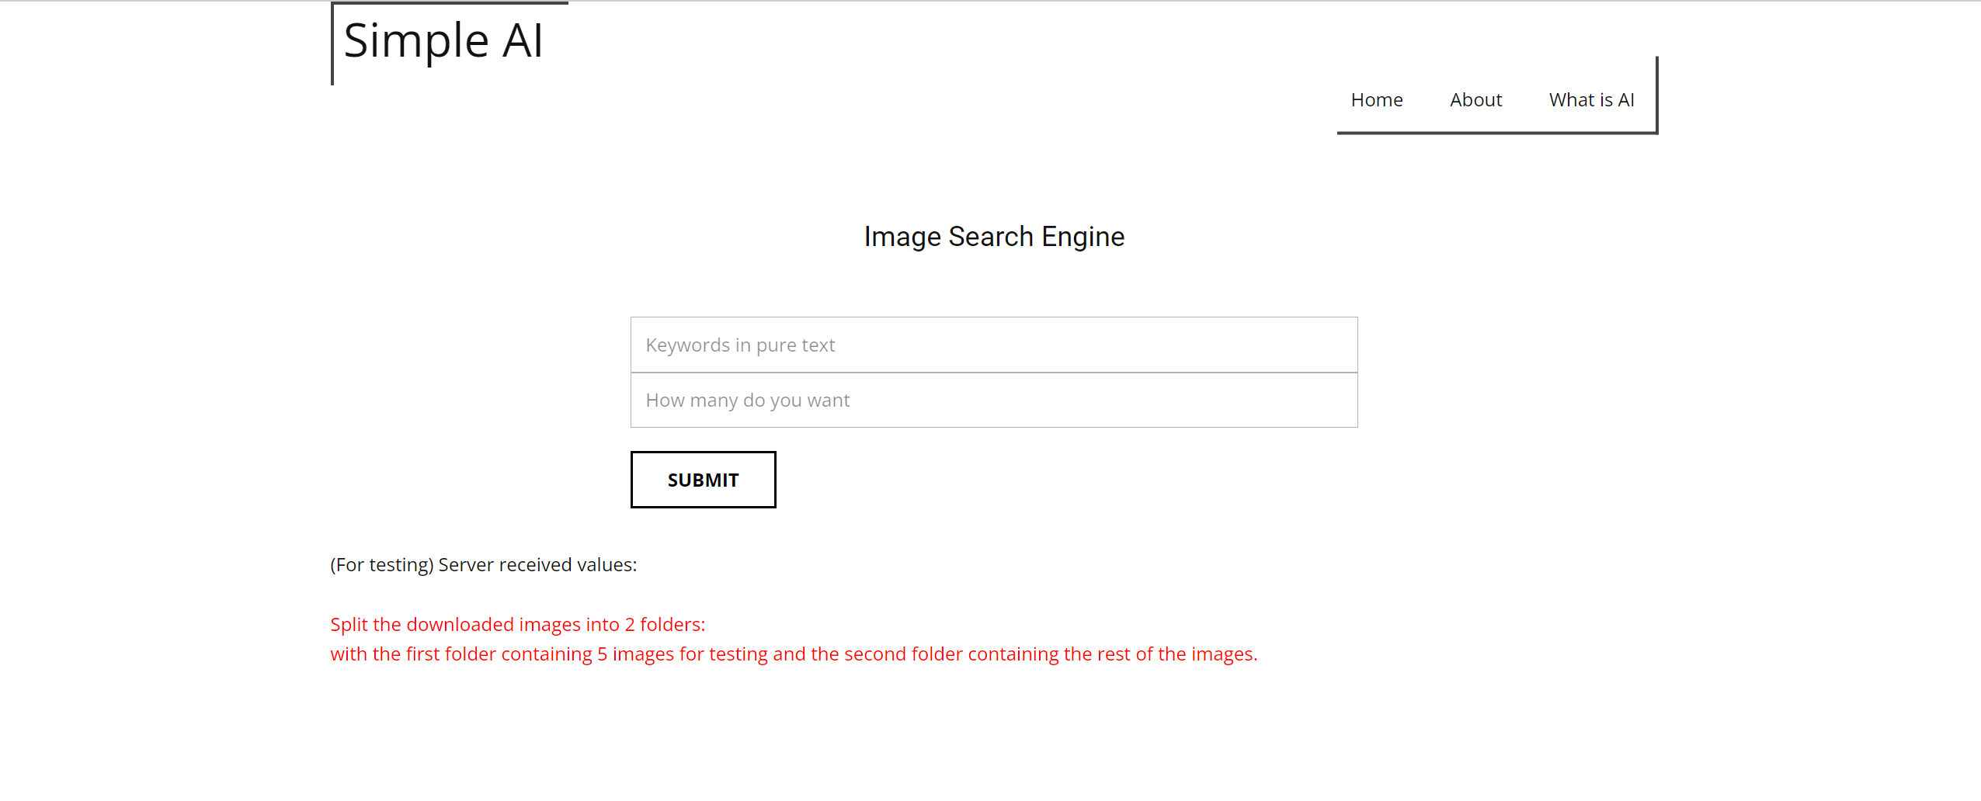
Search for images

Slide 6
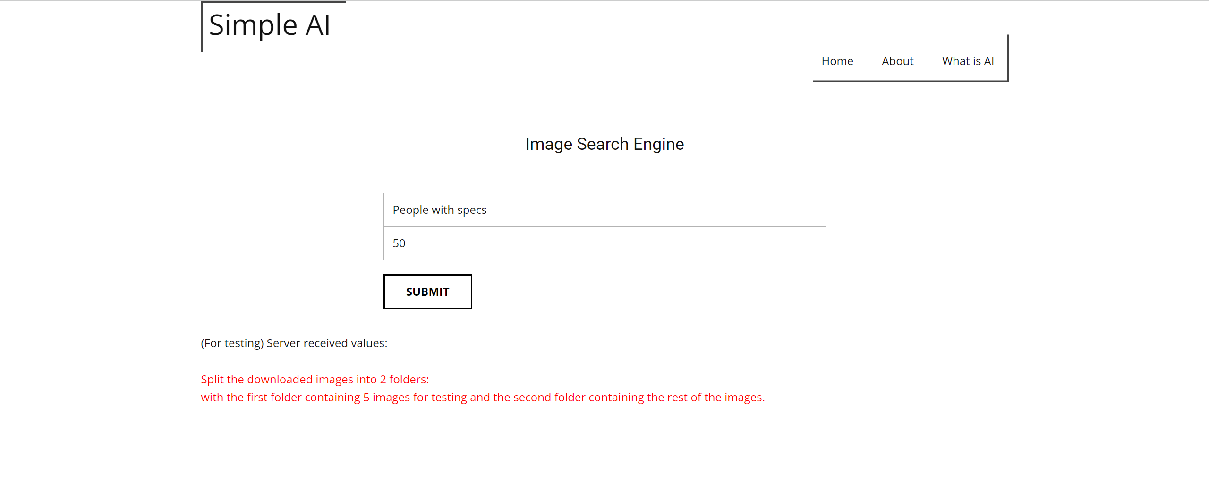
Key in values
In this demonstration, there is going to be only 1 object to be detected
– spectacles.

Slide 7
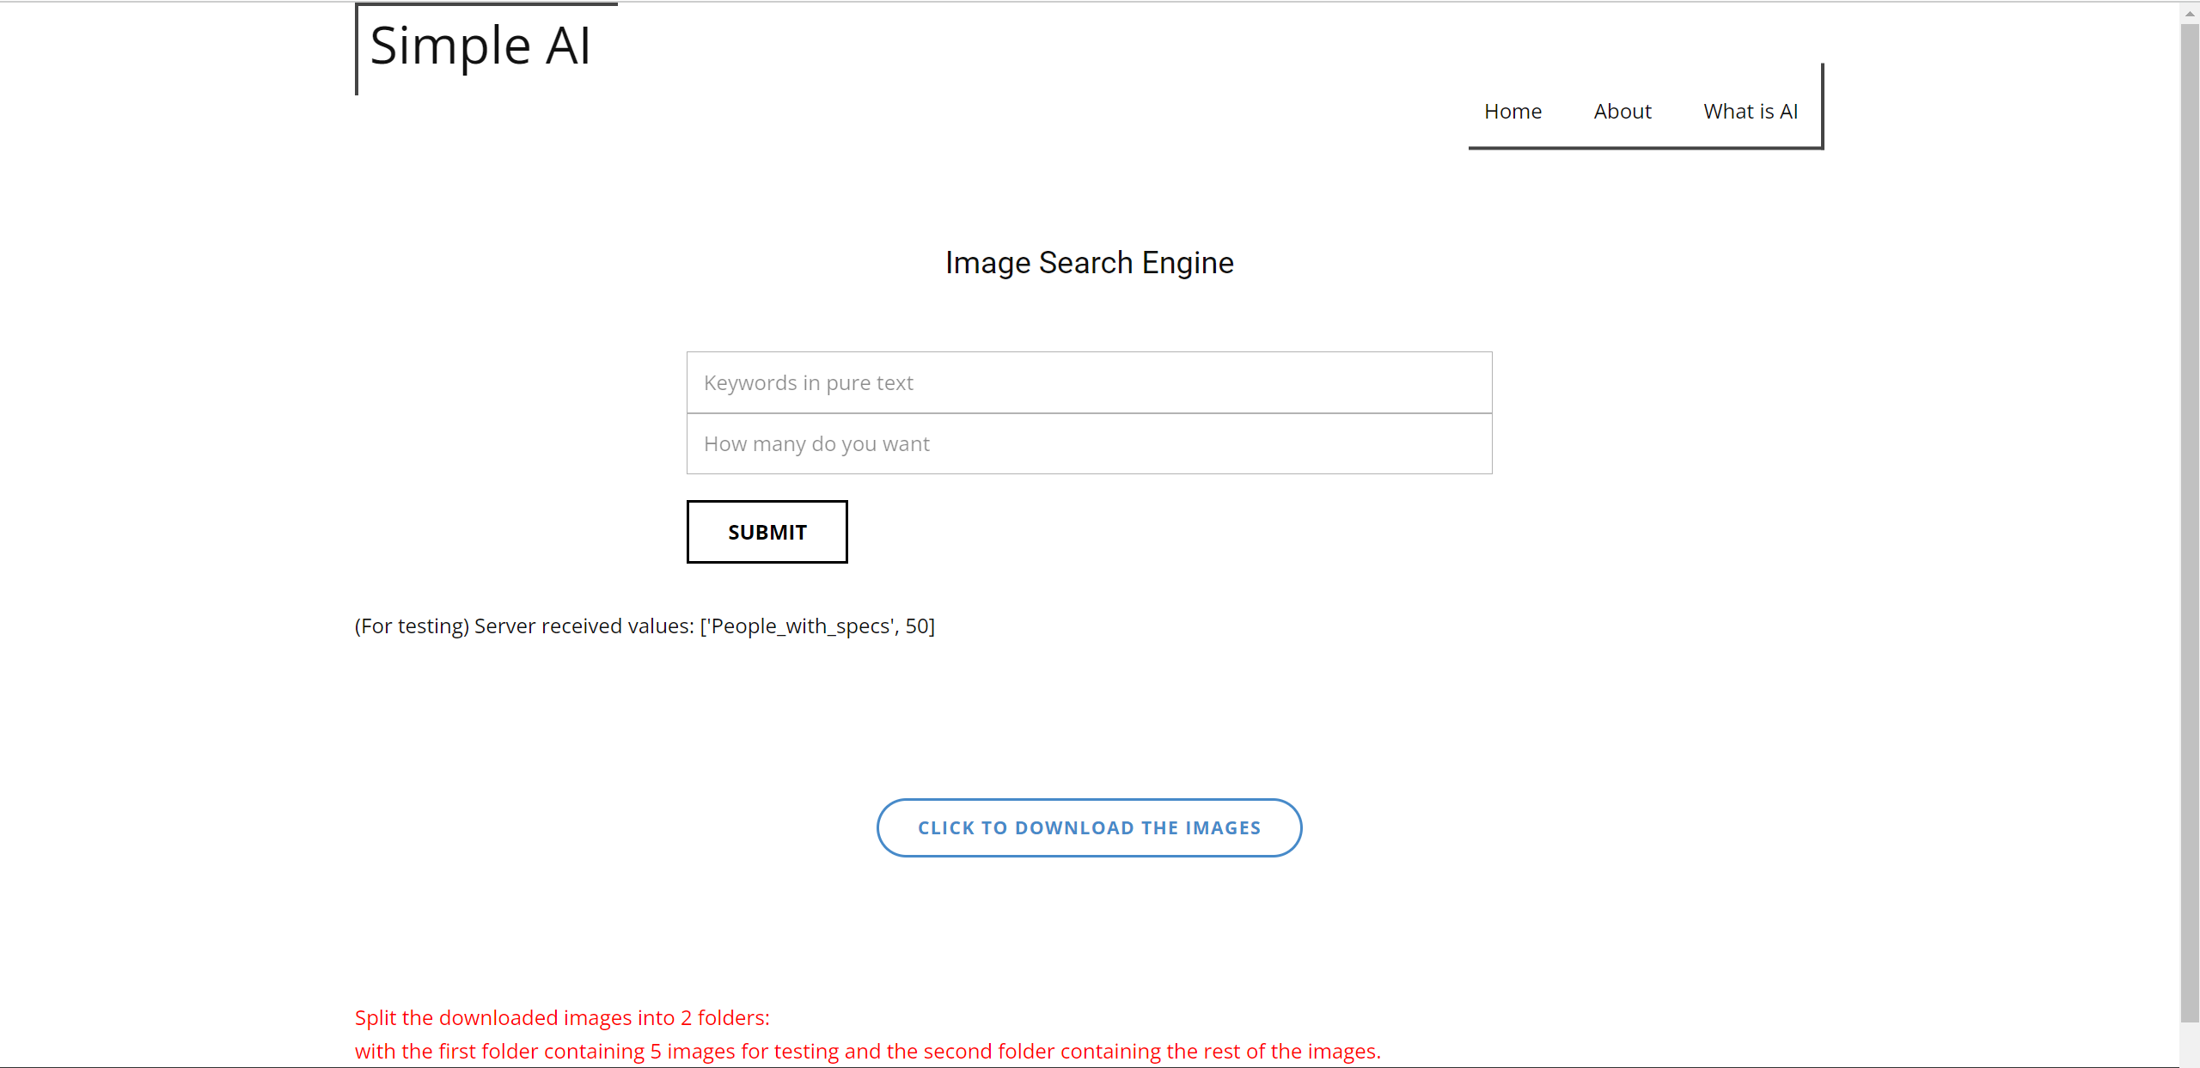
Download button enabled after submitting

Slide 8
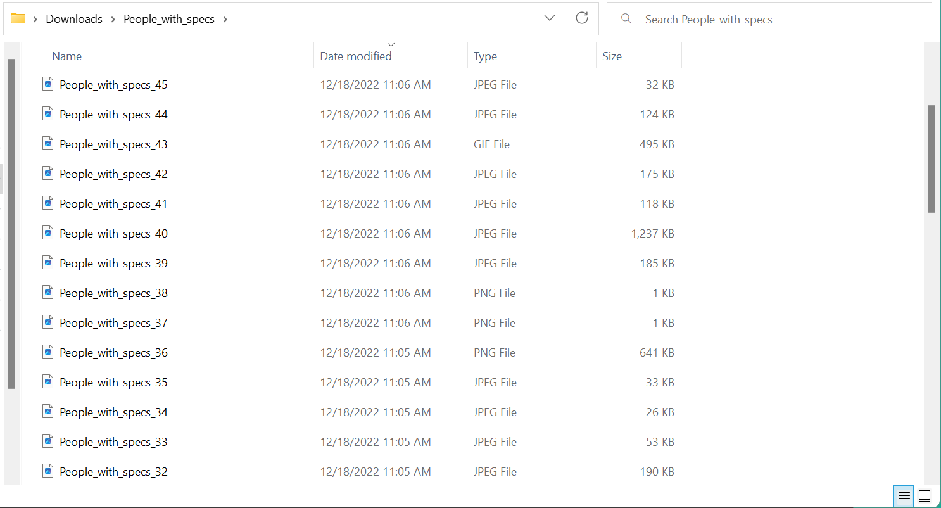
Folder downloaded

Slide 9
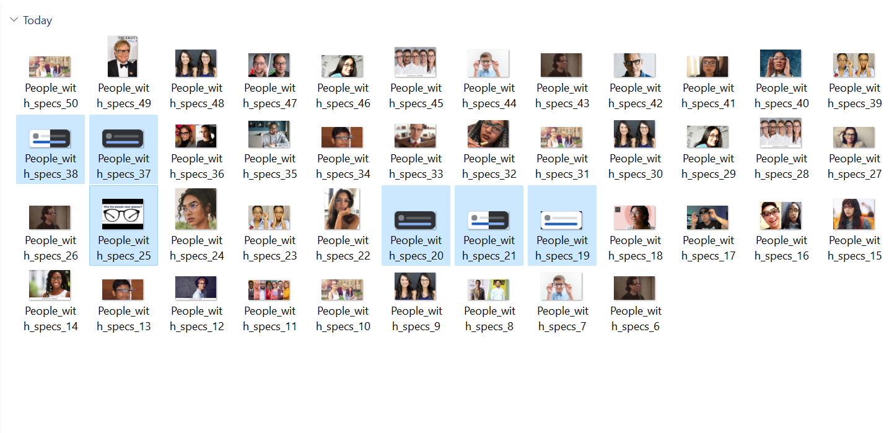
Remove obvious irrelevant pictures, gifs and duplicates (this step can be skipped)

Slide 10
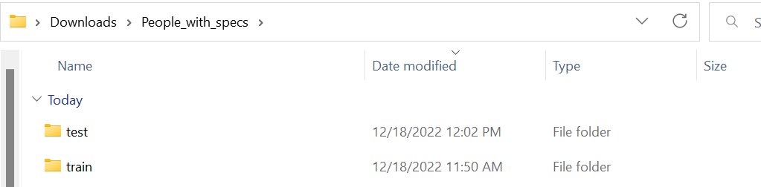
Split into two folders
≈5 images for the test folder
The rest of the images for the train folder

Slide 11
STEP 2

Slide 12
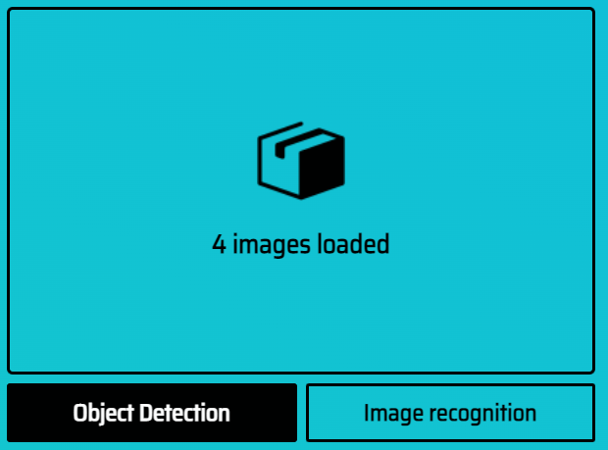

Annotate
Select Object Detection
Annotate using polygons

Slide 13
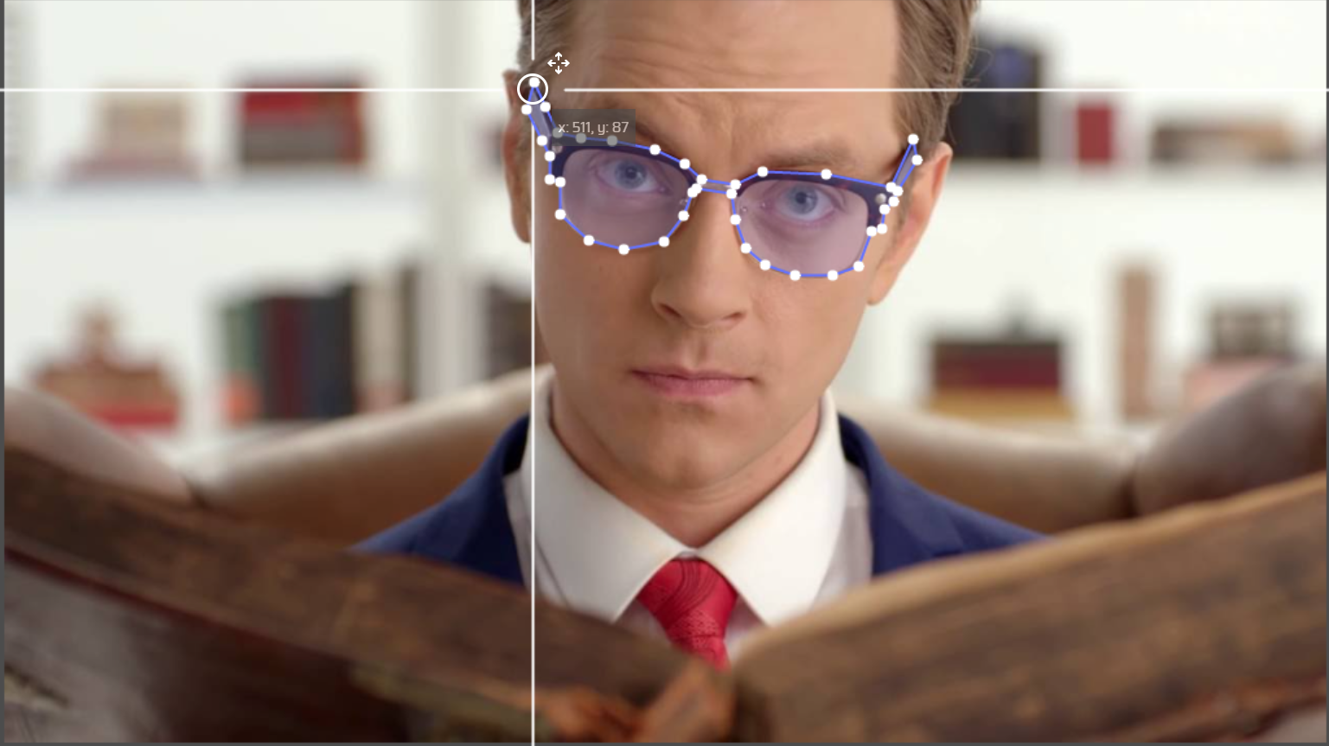

Annotate
Especially when the object is blocked
Be as accurate as possible, but annotation does not need to be perfect.

Slide 14
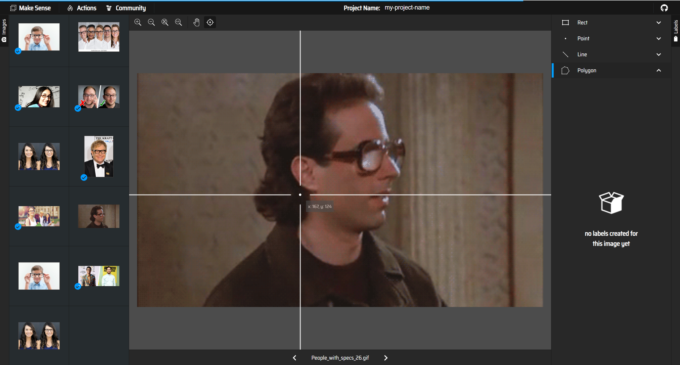
Reminder
If you did not remove the irrelevant pictures, gifs and duplicates, just leave them as they are and do not annotate them. They will not affect the training process later on.

Slide 15
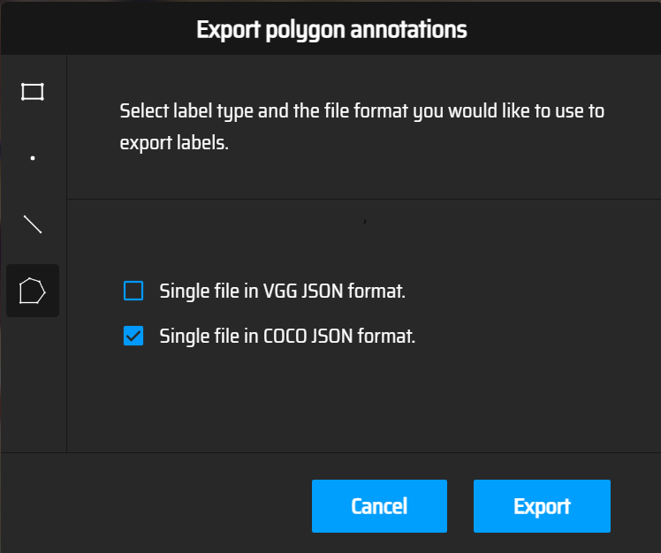
Export in COCO JSON format

Slide 16
STEP 3

Slide 17
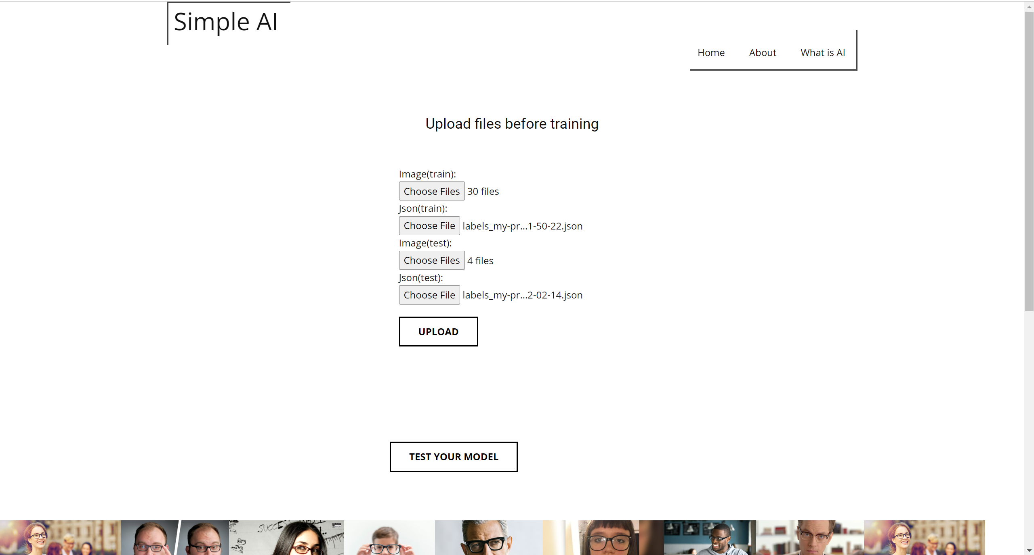
Upload files to Train and Test
Upon uploading, a ‘Train’ button will appear

Slide 18
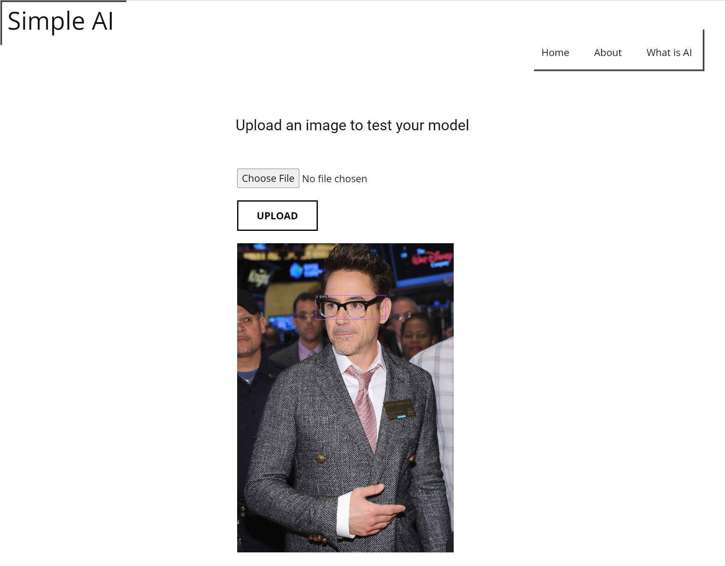
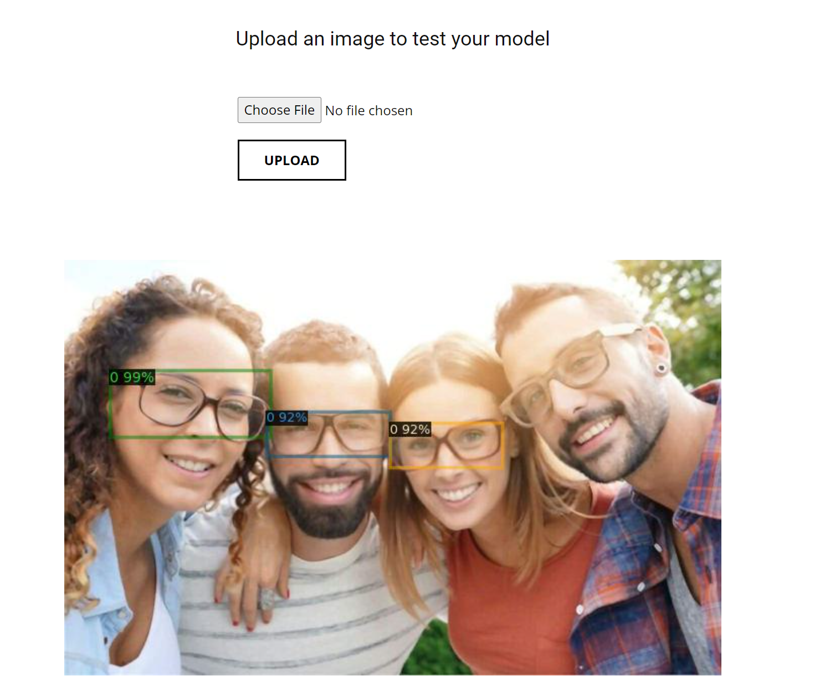
Final results
‘0’ represents index 0. It means that it is the first item (in this case only spectacles) being detected. 99% can be seen as the likelihood of this object being spectacles.

